Slide 1
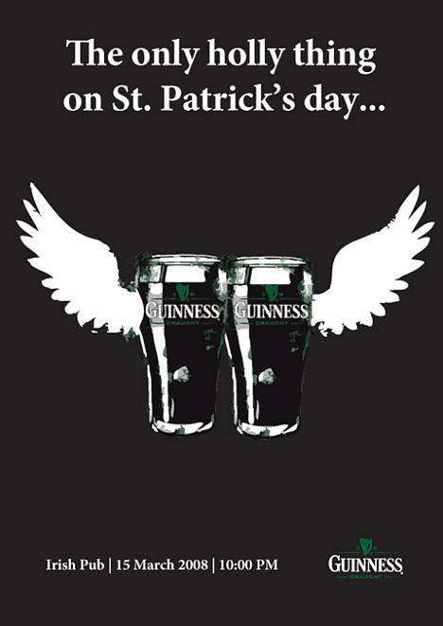
Here’s to Your Health
Joan Dunayer

Slide 2
Detailed Understanding of the Text
1. Joan Dunayer contrasts the glamorous “myth” about alcohol, as pre-
sented in advertising and popular culture, with the reality—which
is often far less appealing. After reading her essay, you will be more
aware of how we are encouraged to think of alcohol as being tied to
happiness and success. You may also become a more critical observer of
images presented by advertisers. (Preview)
►Please explain the reddened words and expressions in English.

Slide 3
Detailed Understanding of the Text
2. Unfortunately, drinking is not unusual among high-school students or, for that matter, in any other segment of our society. And that’s no accident. There are numerous inﬂuences in our society urging people to drink, not the least of which is advertising. Who can recall a televised baseball or basketball game without a beer commercial? (Para. 2)
►Please explain the reddened words and phrases in English.

Slide 4
Detailed Understanding of the Text
3. Furthermore, alcohol ads appear with pounding frequency in magazines, on billboards, and in college newspapers. According to industry estimates, brewers spend more than $600 million a year on radio and TV commercials and another $90 million on print ads. In addition, the liquor industry spends about $230 million a year on print advertising, and since 1966 it has greatly expanded its presence on cable and independent broadcast stations. Just recently, NBC became the ﬁrst network station to accept hard liquor ads for broadcast. (Para. 2)
►Please explain the reddened words and phrases in English.

Slide 5
Detailed Understanding of the Text
4. To top it all off, this aggressive advertising of alcohol fosters a harmful myth about drinking. (Para. 3)
►Please paraphrase the sentence in English.

Slide 6
Detailed Understanding of the Text
5. Part of the myth is that liquor signals professional success. In a slick men’s magazine, one full-page ad for Scotch whiskey shows two men seated in an elegant restaurant. Both are in their thirties, perfectly groomed, and wearing expensive-looking gray suits. The windows are draped with velvet, the table with spotless white linen. Each place-setting consists of a long-stemmed water goblet, silver utensils, and thick silver plates. On each plate is a half-empty cocktail glass. The two men are grinning and shaking hands, as if they’ve just concluded a business deal. The caption reads, “The taste of success.” (Para. 4)
►Please explain the reddened words and expression in English.
►Please translate this part into Chinese.

Slide 7
Detailed Understanding of the Text
6. Contrary to what the liquor company would have us believe, drinking is more closely related to lack of success than to achievement. (Para. 5)
►Please paraphrase the sentence in English.

Slide 8
Detailed Understanding of the Text
6. In the work force, alcoholics are frequently late or absent, tend to perform poorly, and often get ﬁred. Although alcohol abuse occurs in all economic classes, it remains most prevalent among the poor. (Para. 5)
►Please explain the redded words and expressions in English.

Slide 9
Detailed Understanding of the Text
7. The alcohol myth also creates the illusion that beer and athletics are a perfect combination. One billboard features three high-action images: a sprinter running at top speed, a surfer riding a wave, and a basketball player leaping to make a dunk shot. A particular light beer, the billboard promises, “won’t slow you down.” (Para. 8)
►Please explain the reddened words and expressions in English.

Slide 10
Detailed Understanding of the Text
8. Drinking plays a role in over six million injuries each year—not counting automobile accidents. Even in small amounts, alcohol dulls the brain, reducing muscle coordination and slowing reaction time. It also interferes with the ability to focus the eyes and adjust to a sudden change in brightness—such as the ﬂash of a car’s headlights. Drinking and driving, responsible for over half of all automobile deaths, is the leading cause of death among teenagers. Continued alcohol abuse can physically change the brain, permanently impairing learning and memory. Long-term drinking is related to malnutrition, weakening of the bones, and ulcers. It increases the risk of liver failure, heart disease, and stomach cancer. (Para. 9)
►Please explain the basic grammatical structure of the second sentence.
►Please translate this part into Chinese.

Slide 11
Detailed Understanding of the Text
9. Finally, according to the myth, alcohol is the magic ingredient for social success. Hundreds of TV and radio ads have echoed this message in recent years. (Para. 10)
►Please paraphrase the sentence in English.

Slide 12
Detailed Understanding of the Text
10. Indeed, studies show that when alcohol becomes the center of a social gathering, it may lead to public drunkenness and violence. The ad’s image of the man’s new friends ignores an undeniable reality: that alcohol ruins—not creates—relationships. In addition to ﬁghting and simple assault, drinking is linked to two-thirds of domestic violence incidents. Rather than leading to healthy social connections, alcohol leads to loneliness, despair, and mental illness. Over a fourth of the patients in state and county mental hospitals have alcohol problems; more than half of all violent crimes are alcohol-related; the rate of suicide among alcoholics is ﬁfteen times higher than among the general population. (Para. 11)
►Please explain the reddened words and expression in English.

Slide 13
Detailed Understanding of the Text
11. For alcohol’s victims, “Here’s to your health” rings with a terrible irony when it is accompanied by the clink of liquor glasses. (Para. 12)
►Please paraphrase the sentence in English.

